Slide 1
All About Atharv
ATHARV KAMIREDDY

Slide 2
Born
Born in Sammamish, Washington, USA

Slide 3
Family
I Live with my mom and dad
1 brother, age 1
I am 5 years old
my Favorite sport is karate

Slide 4
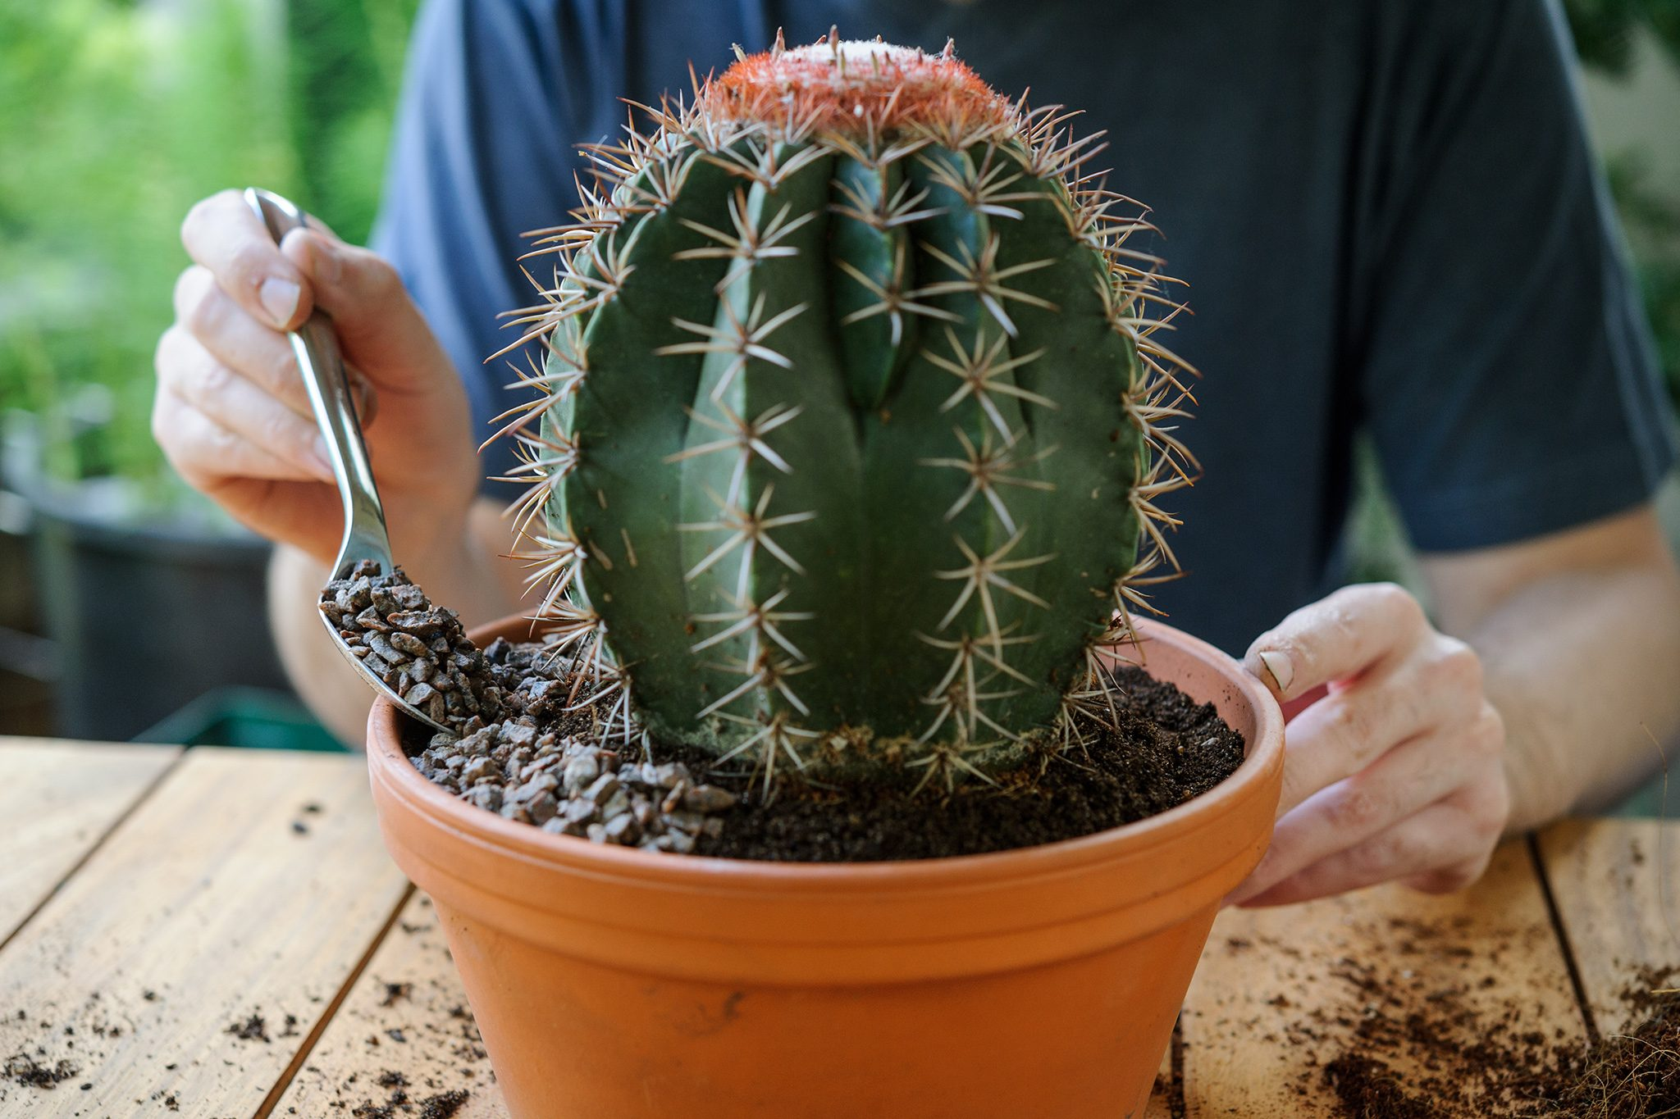
I like to plant things with my grandpa

